Slide 1
Future of the project
Generative music prototype
Simple sounds triggered from automata
Introduce probabilistic models/randomness later
Add gloves input (+kinect)
(easy) add inputs as independant models
(difficult) work on consensus algorithms
(difficult) work on prediction filters to improve the quality of skeleton tracking models

Slide 2
Future of the project
UI and user experience
Final product still not clear; several possibilities: 1) soundpainting learning tool (ok) 2) generic signs/gestures to sound mapper app for any kind of performance (has more potential) 3) a more specific performance tool for a particular setup of my own, with specific settings - for instance with a vibraphone, synth or cargo bike band setup (a lot of potential also, but less genericity for sharing the tool)
Final UI and UX will have to be designed according to this choice
In the case of the soundpainting learning app, it can have the same structure with a more polished look
In the case 3), every control element can be hiden and the app should however generate visuals
In the case 2)… I am unsure

Slide 3
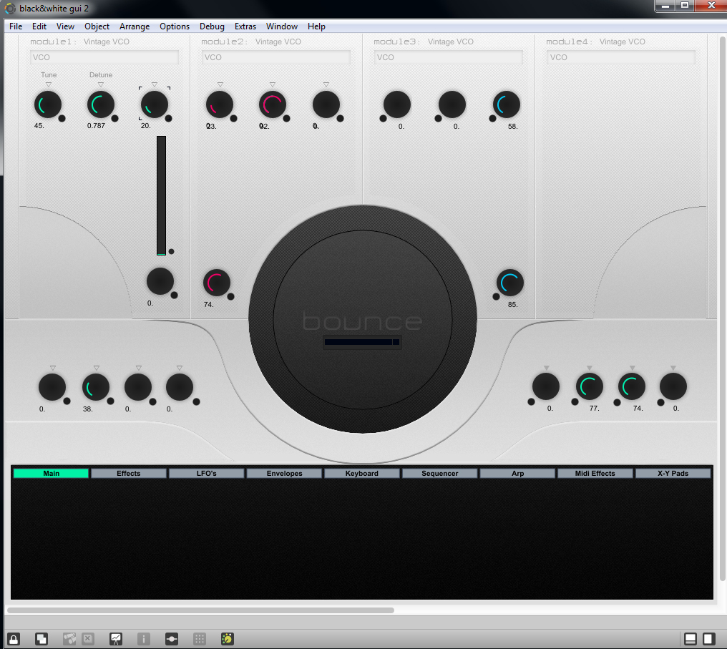
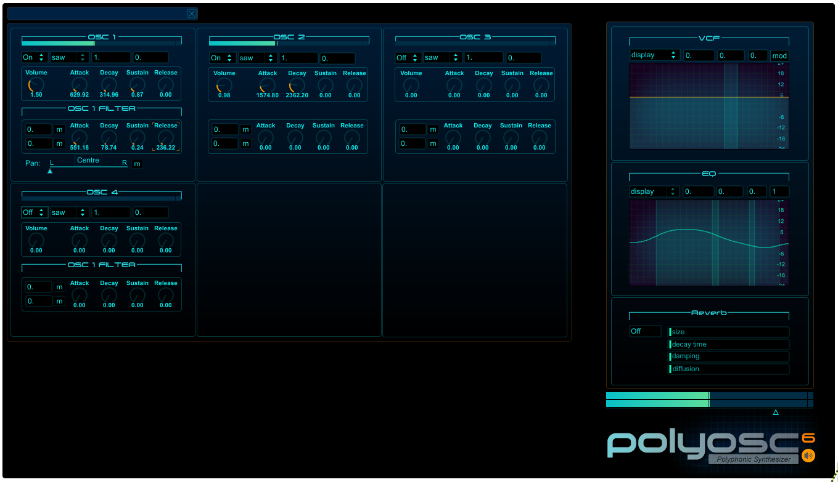
Max/msp gui possibilities

